Slide 1
html tags
MCNDHS
Ms. Eng

Slide 2
aim: How do we create a field set?
Do now:
Daily Grade:
On-time/attendance/not leaving the classroom: 25%
Cellphones: 25%
Notes:25%
Classwork/Homework: 25%

Slide 3
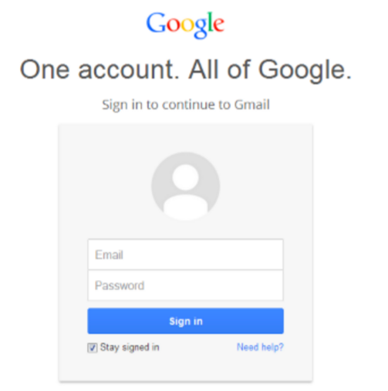

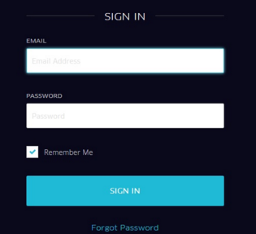
what are we learning today?

Slide 4
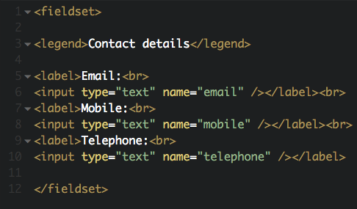
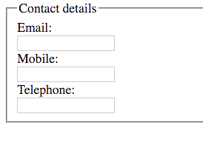
fieldset

Slide 5
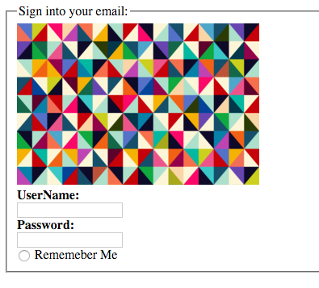
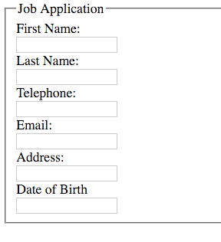
activity

